Slide 1

Annual Report 2020-21
Notes:
The Office of the Ombudsperson prepares an annual report every year, to summarize our work on campus.

Slide 2
Office of the Ombudsperson:
Provides problem solving and conflict resolution.
Serves all faculty, staff and students.
Notes:
Our role is to help students, staff and faculty with conflicts and problems. What makes us different from many other resources on campus is that we work with people following ethical principles set out by our professional association, the International Ombuds Association.

Slide 3

Code of Ethics
Confidential
Neutral/Impartial
Informal
Independent
Notes:
Confidentiality is the bedrock of our office, and the only exceptions to our confidentiality are a risk of physical harm to anyone or if we are ordered by a court or required by law. Our confidentiality can be crucial in surfacing serious issues. In one case, students working in a lab came to us with concerns that a faculty member was falsifying data. They expressed great fear of possible retaliation if their involvement was revealed. After discussing a number of options, the students gave us permission to call the Office of the Vice President for Research and clarify the confidentiality they could offer in this case. The visitors met with the VPR and us to discuss the situation and develop a plan of action that would address their concerns while providing anonymity for them and protecting them from retaliation.

Slide 4
We can:
Listen.
Help analyze a problem.
Identify and explain relevant University policies and procedures.
Help identify options.
Make referrals to other campus resources.
Provide coaching on effective conflict management.
Notes:
We help our visitors clarify their goals, identify the range of options available to them, from informal to formal, and help them develop a plan of action. Our neutrality, in combination with our confidentiality, can be very helpful in this process. In one case, a faculty member received a serious medical diagnosis that would permanently affect their ability to fully function in their department. We were able to talk about all of their concerns, including teaching, supporting graduate students, and research; offer resources; and then help them develop a plan to present to their department chair.

Slide 5
We also:
Carry out shuttle diplomacy by serving as a go-between to resolve problems.
Facilitate group discussions.
Mediate conflicts.
Notes:
Our informality, combined with our confidentiality, provides the opportunity to resolve an issue before having to resort to formal options such as filing a complaint or taking legal action. For example, a staff member contacted us about feeling harassed by another staff member. They didn’t want to file a formal complaint but needed the situation to be resolved. Both people agreed to mediation, and we ended up providing multiple mediation sessions. The result was an agreement that laid out steps to improve their working relationship in the future.

Slide 6
Number of Visitors 1986-2021
Notes:
The 646 visitors we saw last year represents a decline from the prior three years. We believe several factors contributed to this, including faculty, staff and students interacting less due to remote teaching, learning and work and fewer opportunities to publicize the work of our office.

Slide 7
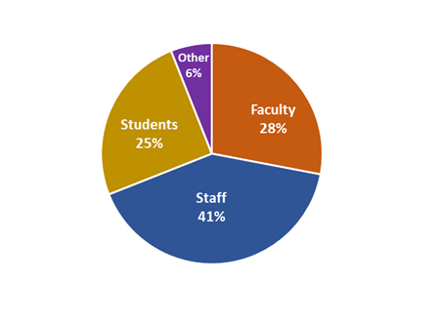
Types of Visitors
Notes:
In 2020-21, UI staff were once again the largest group of visitors we served. Faculty represented 28% of our visitors, which is an increase from 15% in 2015. We also want to point out that we always serve higher percentages of women and people of color than would be predicted based on their populations on campus.

Slide 8
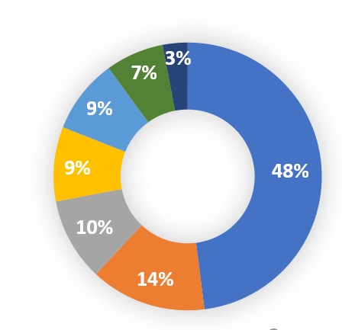
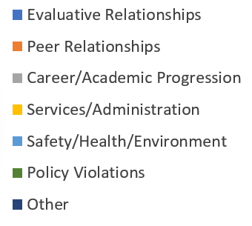
Visitor Concerns
Notes:
The primary reason visitors came to see us this last year involved a problem with an evaluative relationship, meaning a problem with someone whom they evaluate or who evaluates them. An example would be a faculty member having a problem with the behavior of an undergraduate student in one of their classes.

Slide 9
Visitors Experiencing Disrespectful Behavior: 24%
Notes:
This represents a decrease from 30% in 2019-20, which we attribute to the campus being largely remote last year. An example of disrespectful behavior would be a faculty member making condescending comments to another faculty member in a faculty meeting.

Slide 10
Consultations: 79
UI administrators, Human Resources staff, and others seek assistance in managing conflict.
Notes:
For example, an administrator may call to talk about two staff members in conflict, to get ideas on how to address the situation.

Slide 11
Perceived Risks to Campus: 71% of Visitors
Risk | %
Loss of Productivity | 42%
Policy Violations | 18%
Turnover | 15%
Grievance | 15%
Safety | 5%
Negative Publicity | 3%
Litigation | 2%
Notes:
Only 29% of our visitors had situations that did not pose a risk to campus. The biggest risk we continue to see is loss of productivity due to ongoing conflict involving more than two people.

Slide 12
Satisfied Visitors: 86%
Notes:
We send out a brief Qualtrix survey to visitors asking for their feedback.

Slide 13
2020-2021 Themes
  COVID
  Department Responses to Diversity, Equity and Inclusion
  Student Academic Accommodations
Notes:
We have highlighted three issues in our report this year. First, we have seen a lot of distress among faculty, staff and students about public health measures during the pandemic, and we also recognize the constraints on actions by University administration. We ask everyone for kindness, patience and flexibility as the campus deals with the ramifications of the pandemic. Second, we acknowledge that administrators work hard to navigate situations with a DEI component and also want to point out some common errors we see, including delaying action; poor communication with stakeholders; and failure to reach out for help from campus experts. We recommend being alert to DEI components in difficult situations, quickly convening a meeting of key resources to develop a plan of action, and proactively implementing DEI training. Finally, we have seen a number of cases involving students frustrated about academic accommodations for disabilities. This can be a challenging and emotional experience for students. In turn, faculty may not always know how to respond to requests for accommodations and may be overwhelmed by the volume of requests. We recommend more training for faculty and an emphasis on clear expectations for faculty and students around accommodations. We also encourage a more proactive approach to student academic accommodations, including increased collaboration among Student Disability Services and other campus offices, increased awareness of diversity in learning styles, and greater emphasis on universal design.

Slide 14
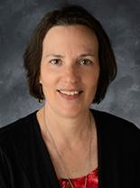
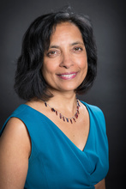
About Us
Cynthia Joyce, MPPM, MES
University Ombudsperson
Meenakshi Gigi Durham, PhD
University Ombudsperson
Notes:
We are delighted to welcome Gigi Durham as our new faculty ombuds. Gigi is a Professor and College of Liberal Arts and Sciences Collegiate Scholar in Journalism and Mass Communication with a joint appointment in Gender, Women’s and Sexuality Studies. Cynthia has been with the office since 2005.

Slide 15
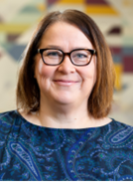
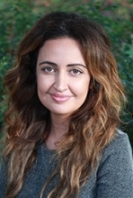
About Us
Jennifer Lynch, MS, MSEd
Associate Ombudsperson
Nadia Sabbagh Steinberg, LMSW, PhD
Associate Ombudsperson
Notes:
Jennifer joined the office as an interim Associate Ombudsperson in November 2020 and has a joint appointment as a program director in the Center for Diversity and Enrichment. Nadia joined the office as an interim Associate Ombudsperson in January 2021. She is a Lecturer in the School of Social Work with 10 years of clinical practice experience.

Slide 16
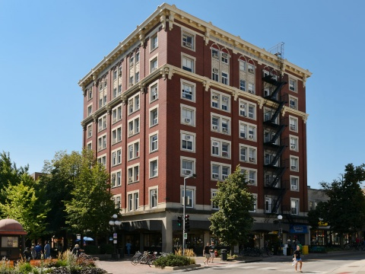
Contact Information
Third Floor
Jefferson Building
129 E Washington Street
319-335-3608
ombudsperson@uiowa.edu
https://ombudsperson.org.uiowa.edu
Notes:
Due to the COVID19 pandemic, the ombudspersons work primarily by telephone, ZOOM or SKYPE. In-person meetings are scheduled upon request. Please contact the office by email or telephone to schedule an appointment. Detailed information about the Office of the Ombudsperson may be found on our website.

Slide 17
Contact us for virtual or in-person presentations.
Notes:
Please contact us if you are interested in virtual or in-person presentations of this report or an overview of our office.

Slide 18
No problem too big or too small. Let’s talk!
Notes:
Our tagline encourages faculty, staff and students to come to us with small issues as well as major concerns, and everything in between.

